Slide 1
Analysis of the book “Harry Potter”
Faculty of Humanities
Applied Linguistics and Text Analytics
Nizhniy Novgorod
2024
Prepared by
Guseva Anastasia
Oreshnikova Viktoria
Malysheva Tatyana

Slide 2
Outline:
Faculty of Humanities
Applied Linguistics and Text Analytics
Nizhniy Novgorod
2024
Goals and objectives;
Research material;
Research tools;
Analysis process:
Lowercasing
Punctuation removal
Stop words removal
Parts of speech tagging
POS
Tokenization
Stemming and lemmatization
Exploratory data analysis
N-grams
Term Frequency-Inverse Document Frequency (TF-IDF)
Text similarity
Information extraction – NER – Entity recognition
Topic modeling
Sentiment analysis
5. Conclusions

Slide 3
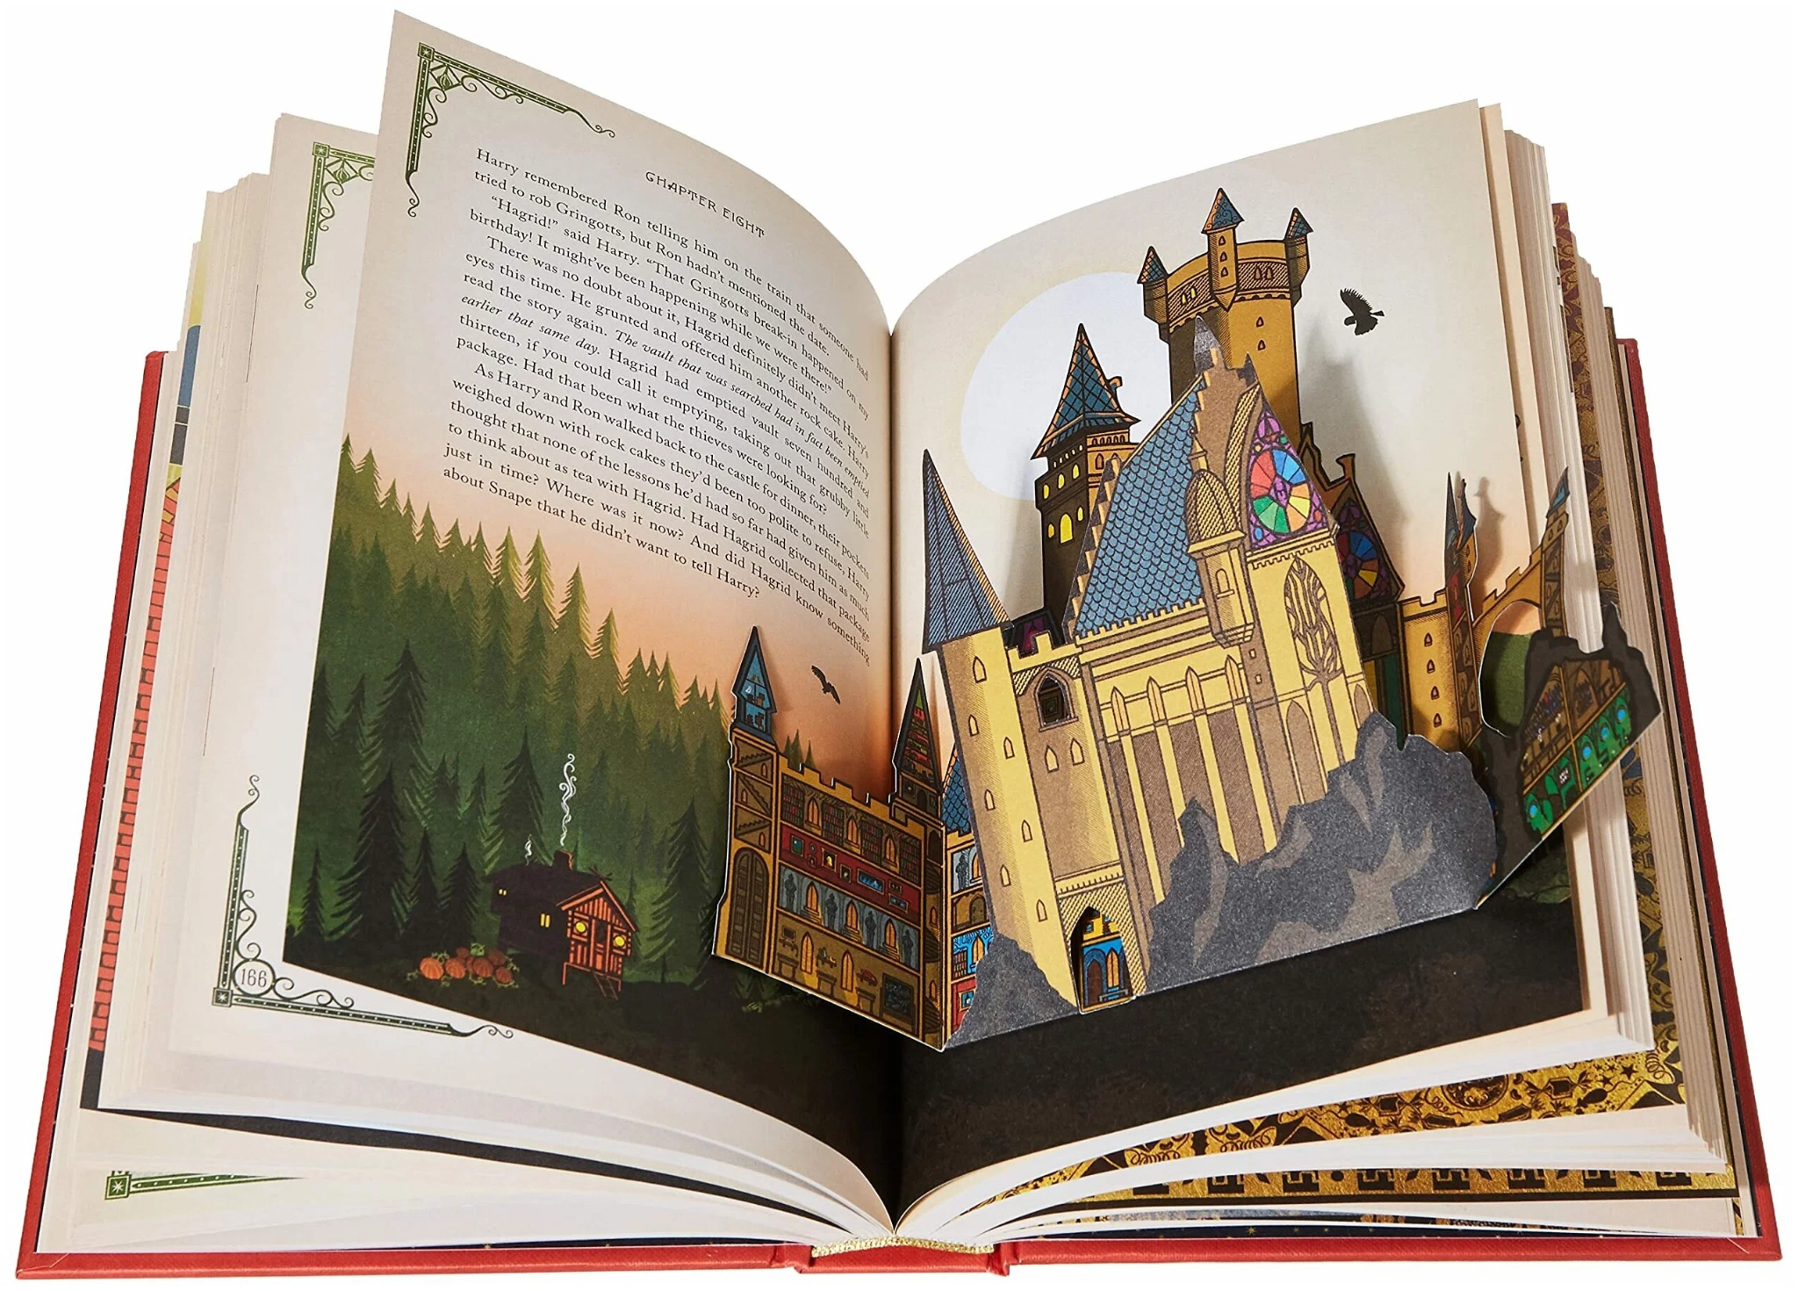
Faculty of Humanities
Applied Linguistics and Text Analytics
Nizhniy Novgorod
2024
Goals and objectives
Objectives:
1) Prepare the text for analysis (text preprocessing);
2) Determine the frequency parts of speech in the text of the book and highlight typical phrases;
3) Identify a similarity score between the books Harry Potter and the Philosopher’s Stone, Harry Potter and the Chamber of Secrets and Harry Potter and the Prisoner of Azkaban;
4) Identify the characters of the book;
5) Find main topics in the text;
6) Determine the emotional tone of the text (positive, negative, neutral or compound).
The aim of the study is to learn as much as possible about the plot and main characters of the first Harry Potter book and to compare it with other two books of that series only with the help of Python codes and NLP libraries.

Slide 4

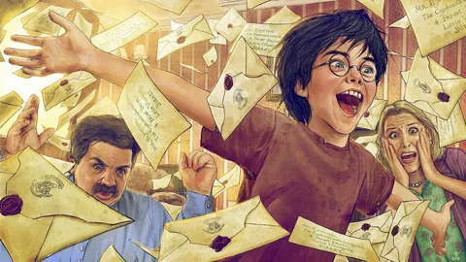

Faculty of Humanities
Applied Linguistics and Text Analytics
Nizhniy Novgorod
2024
Research material
The research material is the text of the book Harry Potter and the Philosopher's Stone in the original (format txt).
Also, in some parts of the code, the books Harry Potter and the Chamber of Secrets and Harry Potter and the Prisoner of Azkaban (format txt) were analyzed.

Slide 5
Faculty of Humanities
Applied Linguistics and Text Analytics
Nizhniy Novgorod
2024
Research tools
Text analysis was carried out using Python libraries: nltk, spacy, re, gensim, sklearn, vaderSentiment.
Natural language processing techniques used:
Converting text to lower case (lowercasing);
Punctuation removal;
Stop words removal;
Parts of speech tagging;
Tokenization;
Stemming and lemmatization;
Word cloud;
N-grams;
Term frequency-inverse document frequency or TF-IDF;
Text similarity;
Information extraction – NER – entity recognition;
Topic modeling;
Sentiment analysis.

Slide 6
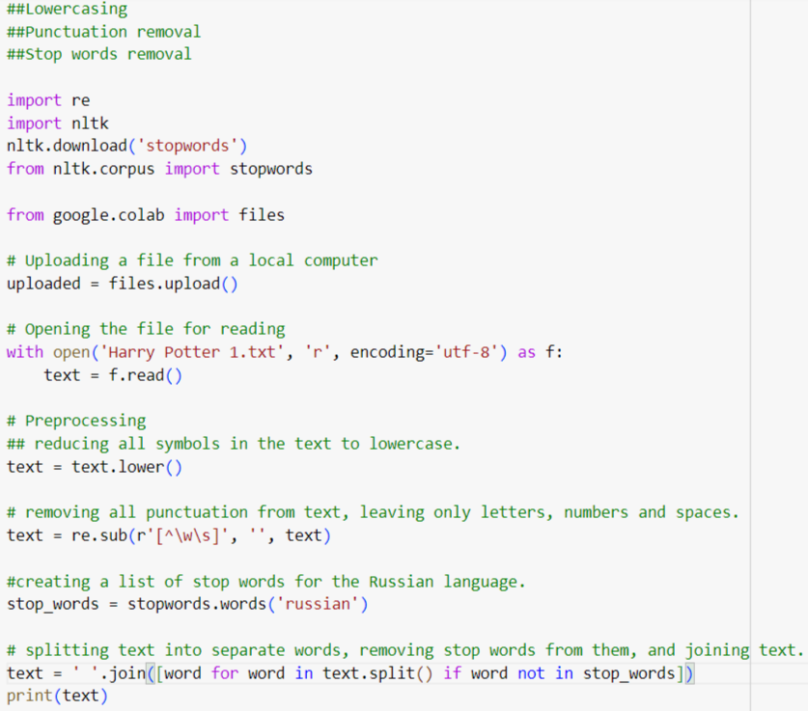
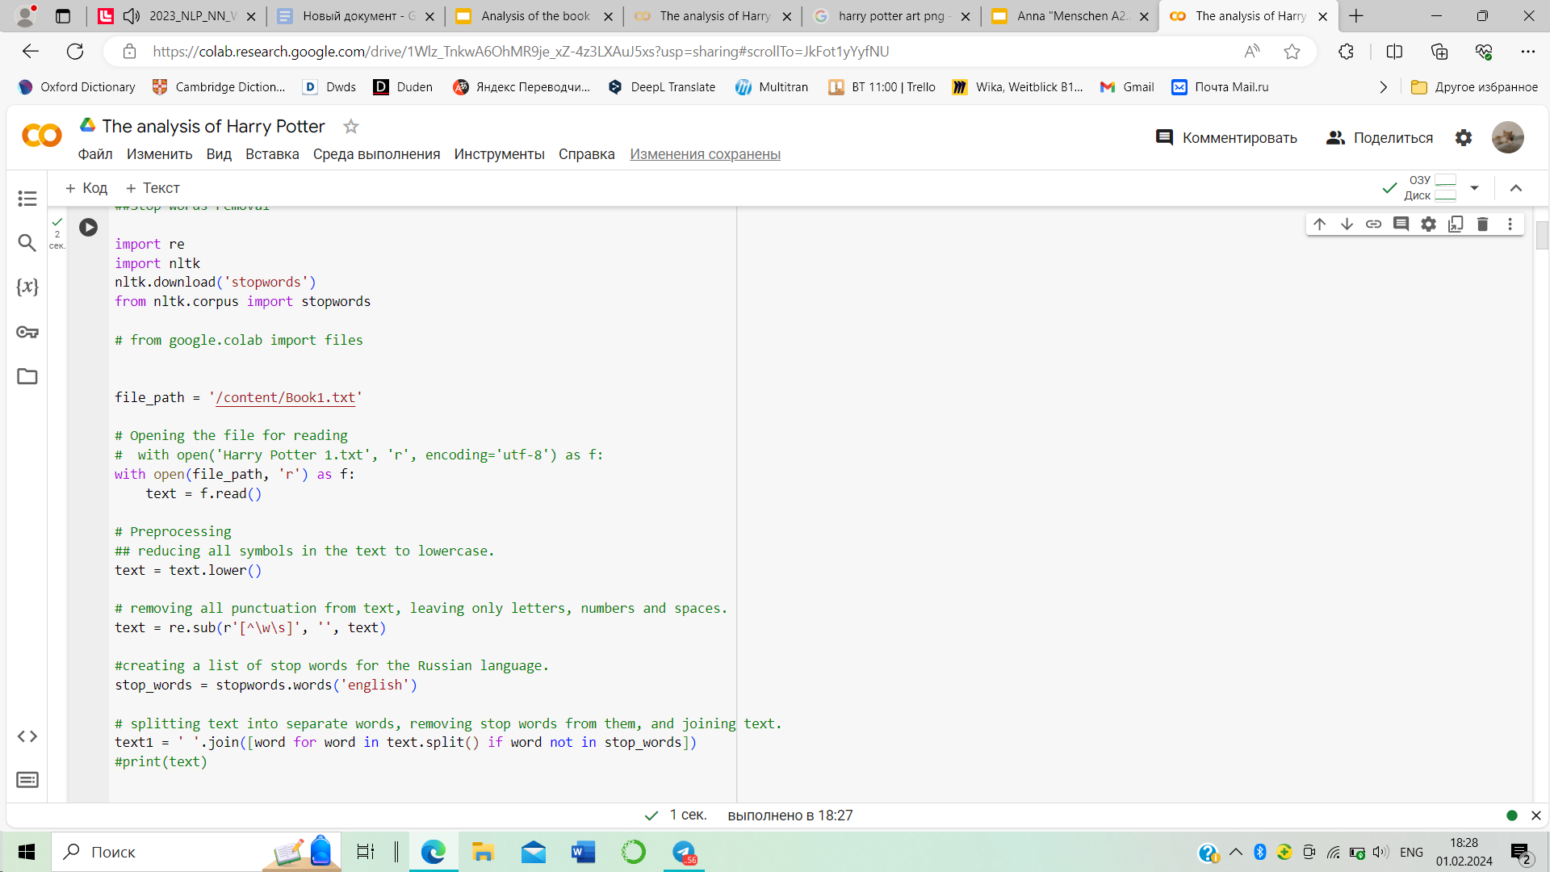
Faculty of Humanities
Applied Linguistics and Text Analytics
Nizhniy Novgorod
2024
Analysis process
Lowercasing
Punctuation removal
Stop words removal
This code is part of the text pre-processing process that is necessary for further text analysis using natural language processing techniques. Text preprocessing helps remove unnecessary elements from data, improve the quality of models, and speed up calculations.

Slide 7
Faculty of Humanities
Applied Linguistics and Text Analytics
Nizhniy Novgorod
2024
Analysis process
Lowercasing
Punctuation removal
Stop words removal
Output is clean converted text without punctuation, stop words or capital letters.

Slide 8
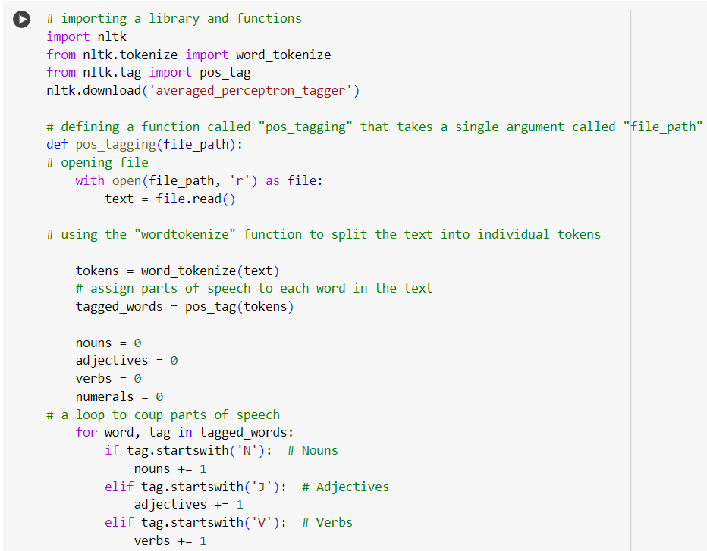

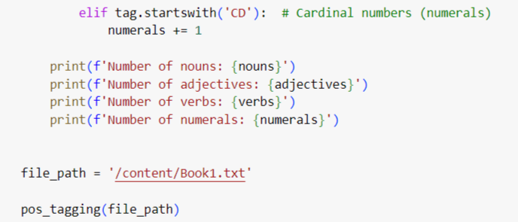
Faculty of Humanities
Applied Linguistics and Text Analytics
Part-of-Speech (POS) Tagging
importing a library and functions
defining a function called "pos_tagging" that takes a single argument called "file_path"
opening file
using the "wordtokenize" function to split the text into individual tokens
assign parts of speech to each word in the text
a loop to coup parts of speech

Slide 9
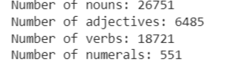
Faculty of Humanities
Applied Linguistics and Text Analytics
Nizhniy Novgorod
2024
Part-of-Speech (POS) Tagging
a significant number of characters, objects, or places in the book
fast-paced plot
characters' actions and decisions, highlighting their roles in driving the narrative forward

Slide 10
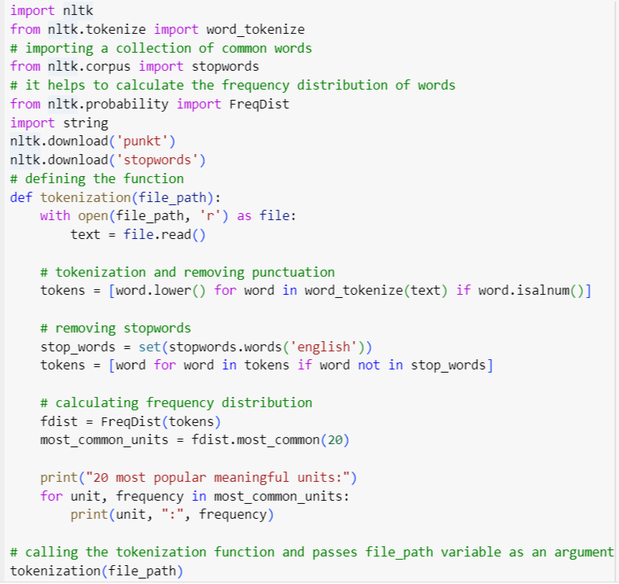
Faculty of Humanities
Applied Linguistics and Text Analytics
Nizhniy Novgorod
2024
Tokenisation
importing necessary libraries and downloading required datasets
defining a function called "tokenization"
tokenization and removing punctuation
removing stopwords
calculating frequency distribution

Slide 11
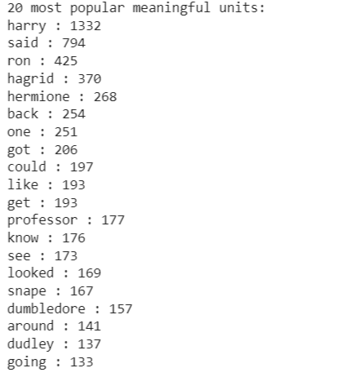
Faculty of Humanities
Applied Linguistics and Text Analytics
Nizhniy Novgorod
2024
Tokenisation
The high frequency of "harry" suggests that the character Harry Potter is central to the plot and likely plays a significant role in the story.
The frequent occurrence of "said" indicates a considerable amount of dialogue within the narrative.
The appearance of character names such as "ron," "hagrid," "hermione," "snape," and "dumbledore" suggests that these individuals are key characters in the story, and they are likely to have significant presence and influence on the events.
The words "professor" and "dudley" denote specific characters and underline their potential involvement in the plot.

Slide 12
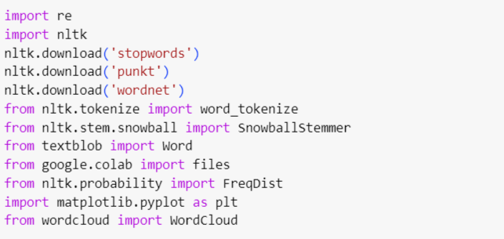
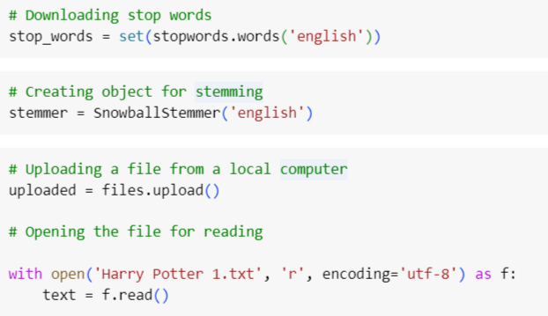
Faculty of Humanities
Applied Linguistics and Text Analytics
Nizhniy Novgorod
2024
Stemming and lemmatization
Stemming and lemmatization help to normalize text by reducing words to their base form
This step is needed to improve the accuracy of the further tasks such as text information retrieval, and sentiment analysis.

Slide 13
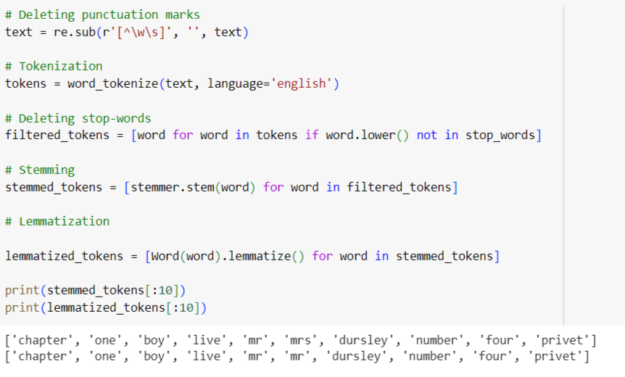
Faculty of Humanities
Applied Linguistics and Text Analytics
Nizhniy Novgorod
2024
Stemming and lemmatization
Stemming is a rule-based process of removing suffixes from words to reduce them to their base form
Lemmatization, on the other hand, involves reducing words to their "lemma," which is the base or dictionary form of a word.
However, the results are the same

Slide 14
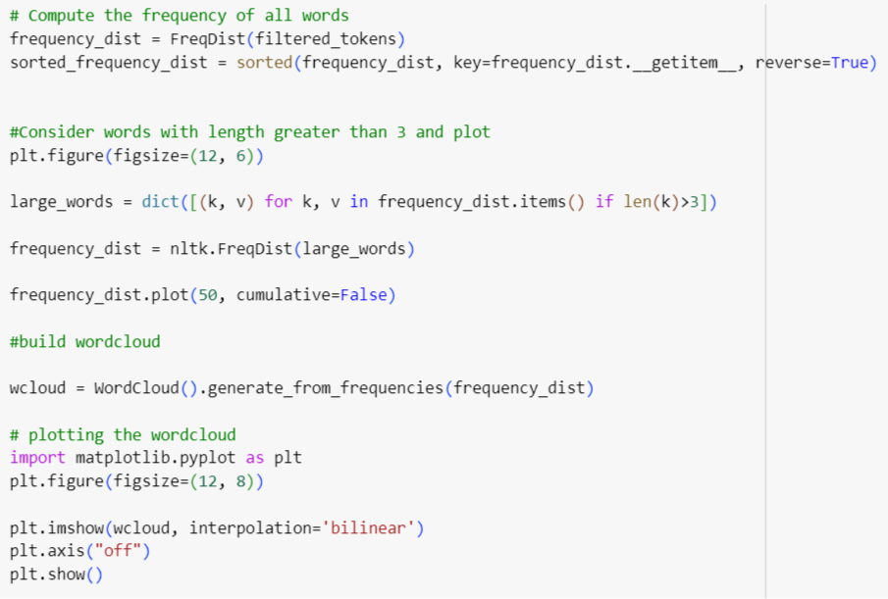
Faculty of Humanities
Applied Linguistics and Text Analytics
Nizhniy Novgorod
2024
Exploratory data analysis
1 . The code compute the frequency of all words in a given text using the FreqDist function. This helps in understanding how often each word appears in the text.
2. The code sorts the frequency distribution in descending order to identify the most common words in the text.
3. The code filters out words with a length less than or equal to 3 and plots a frequency distribution of the remaining words. This is helpful for visualizing the frequency of longer words in the text.

Slide 15
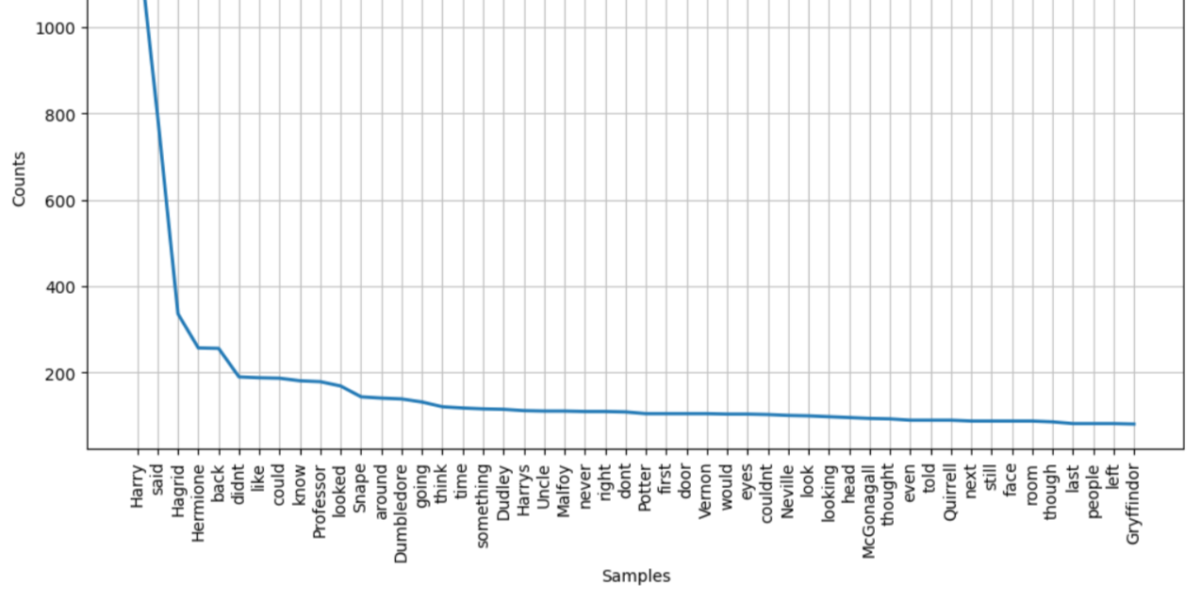
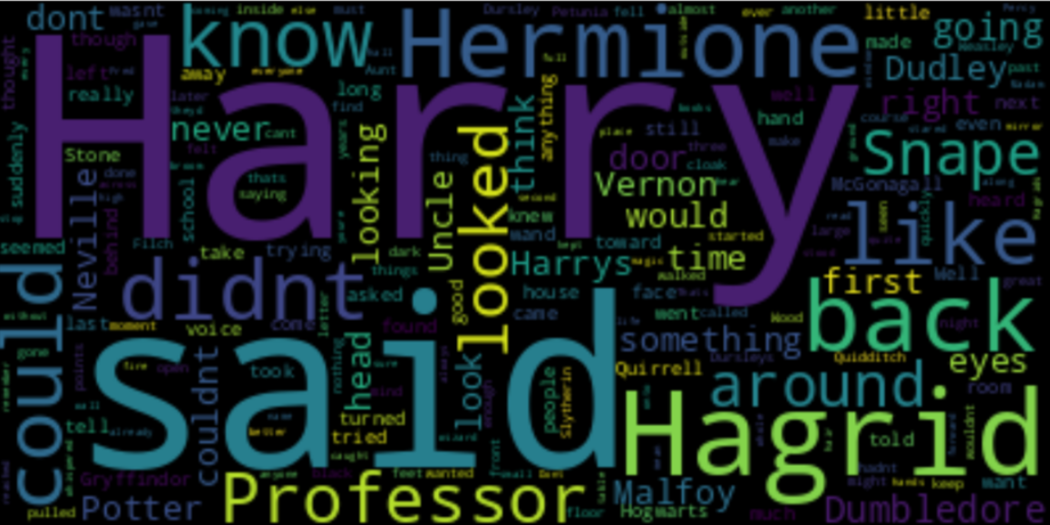
Faculty of Humanities
Applied Linguistics and Text Analytics
Nizhniy Novgorod
2024
Exploratory data analysis
It generates a word cloud based on the frequency distribution of the words, using the WordCloud library.
The world cloud demonstrates the words that occur the most often.

Slide 16
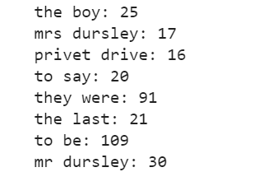
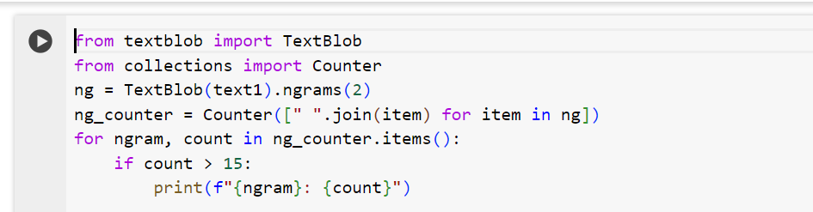
Faculty of Humanities
Applied Linguistics and Text Analytics
Nizhniy Novgorod
2024
N-grams
In this code we use the TextBlob library to count the frequency of bigrams (pairs of words) in a given text and prints out the bigrams that appear more than 15 times.

Slide 17
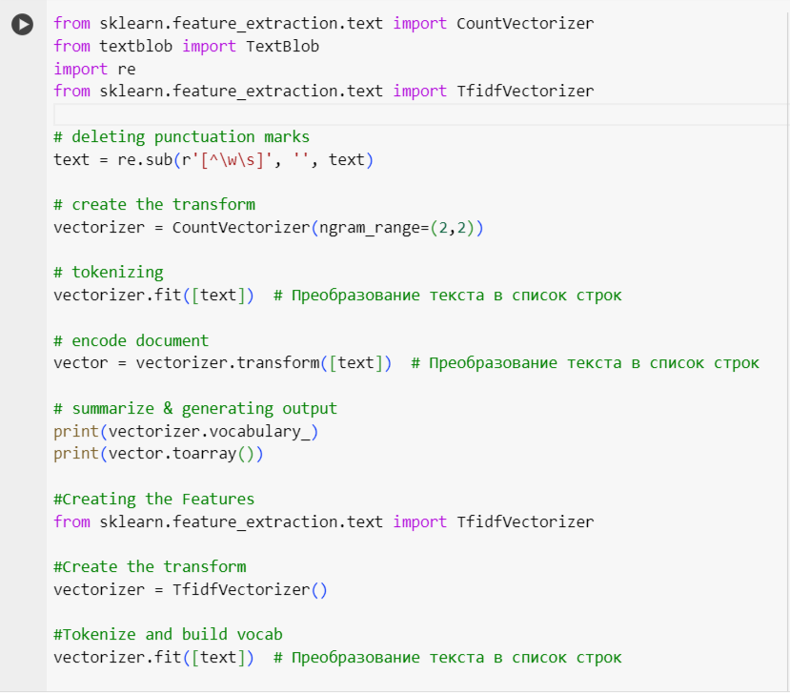
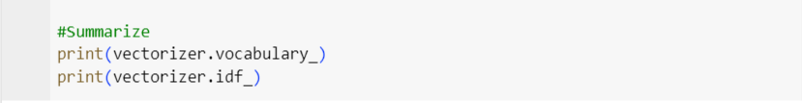
Faculty of Humanities
Applied Linguistics and Text Analytics
Nizhniy Novgorod
2024
Term Frequency-Inverse Document Frequency (TF-IDF)

Slide 18
Faculty of Humanities
Applied Linguistics and Text Analytics
Nizhniy Novgorod
2024
Term Frequency-Inverse Document Frequency (TF-IDF)
The code is used to preprocess the text, generate bigram features using CountVectorizer, and create TF-IDF features using TfidfVectorizer. The code provides insights into how to transform raw text into a numerical representation. The results can be used for machine learning tasks such as text classification or clustering.

Slide 19
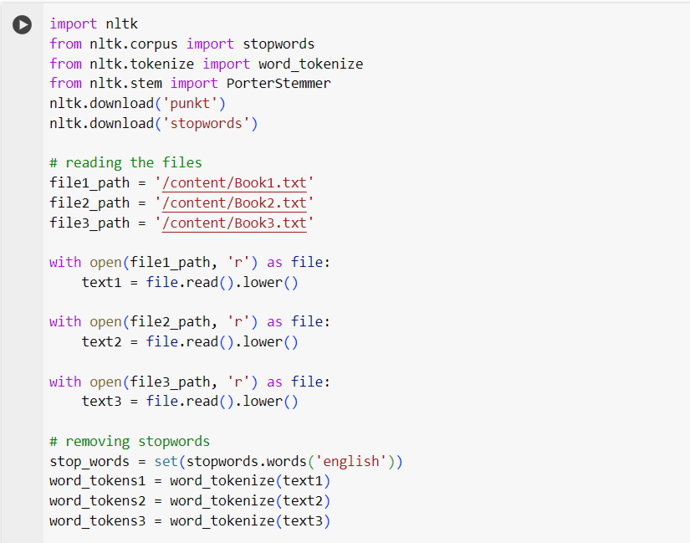
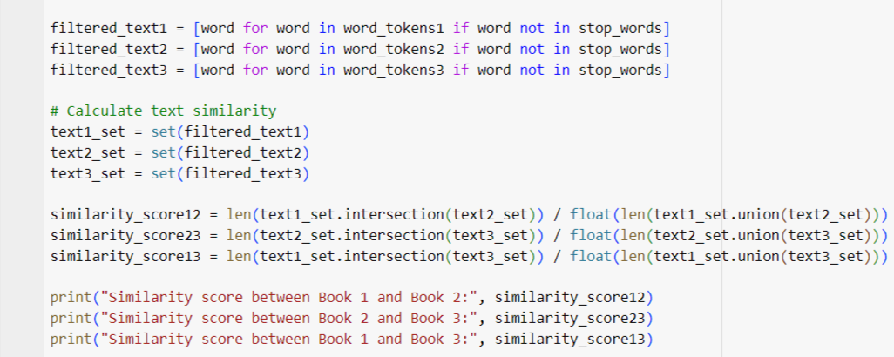
Faculty of Humanities
Applied Linguistics and Text Analytics
Nizhniy Novgorod
2024
Text Similarity
importing a library and functions
reading the files
removing stopwords
Calculate text similarity

Slide 20
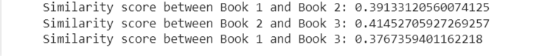
Faculty of Humanities
Applied Linguistics and Text Analytics
Nizhniy Novgorod
2024
Text Similarity
There are significant differences in the plot between the books. The plot of each book in the series is distinct and unique. It suggests that there is a progression and development in the story as it unfolds across the series.

Slide 21
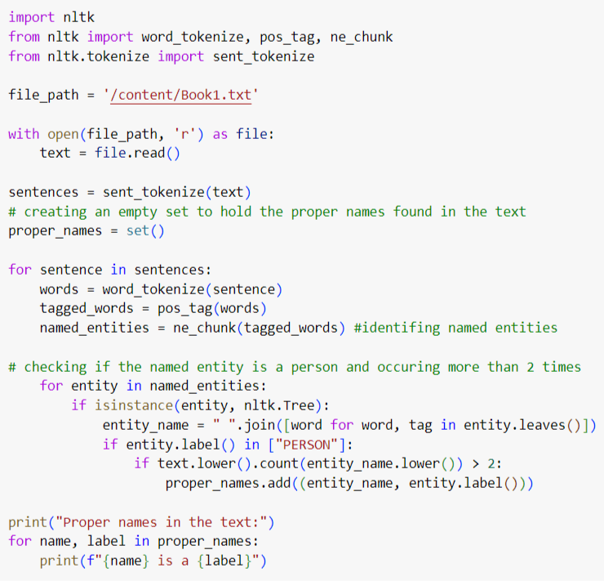
Faculty of Humanities
Applied Linguistics and Text Analytics
Nizhniy Novgorod
2024
Information extraction – NER – Entity recognition
Using NLTK
importing a library and functions
reading the files
tokenization
creating an empty set to hold the proper names found in the text
checking if the named entity is a person and occuring more than 2 times

Slide 22
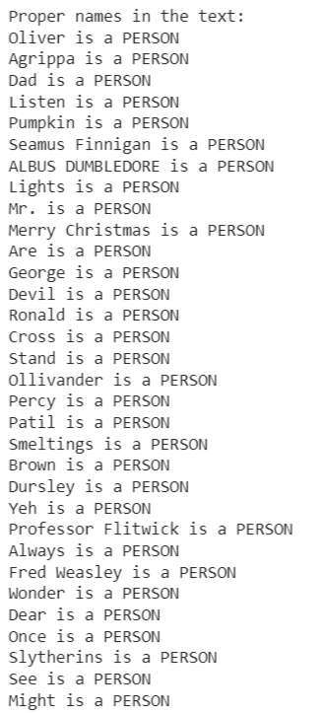

Faculty of Humanities
Applied Linguistics and Text Analytics
Nizhniy Novgorod
2024
Information extraction – NER – Entity recognition

Slide 23
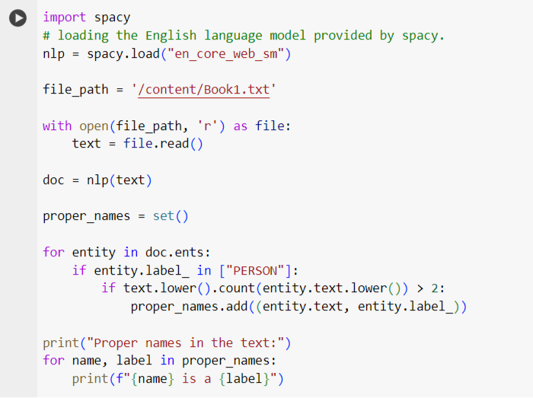
Faculty of Humanities
Applied Linguistics and Text Analytics
Nizhniy Novgorod
2024
Information extraction – NER – Entity recognition
Using SpaCy

Slide 24
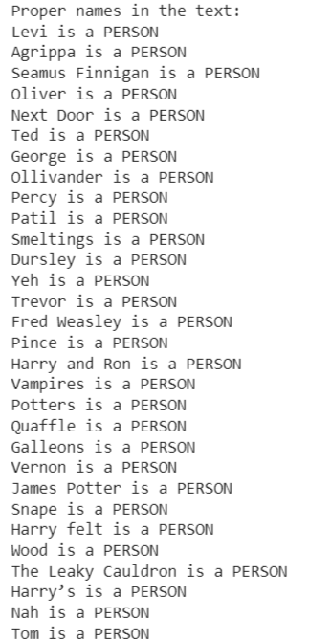
Faculty of Humanities
Applied Linguistics and Text Analytics
Information extraction – NER – Entity recognition
Using SpaCy

Slide 25
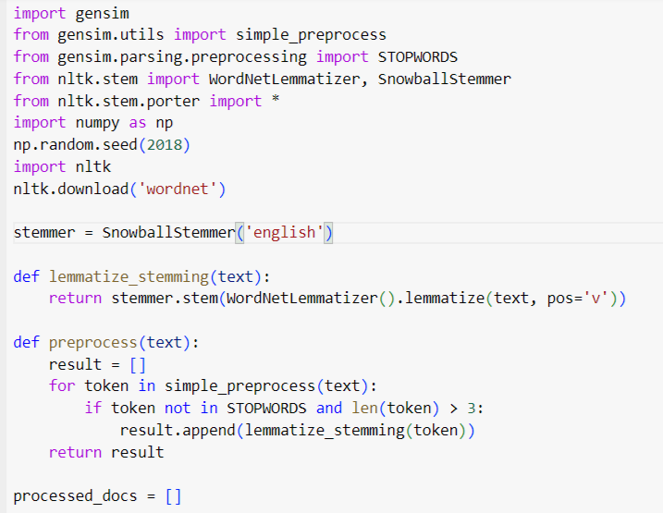
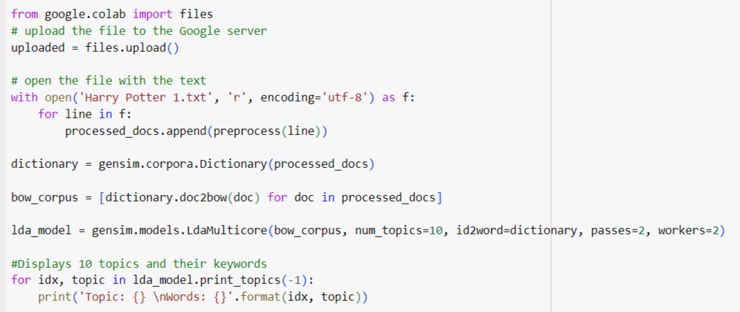
Faculty of Humanities
Applied Linguistics and Text Analytics
Nizhniy Novgorod
2024
Analysis process
Topic modeling
This code is an example of topic modeling, which allows you to find hidden topics in large collections of text.

Slide 26
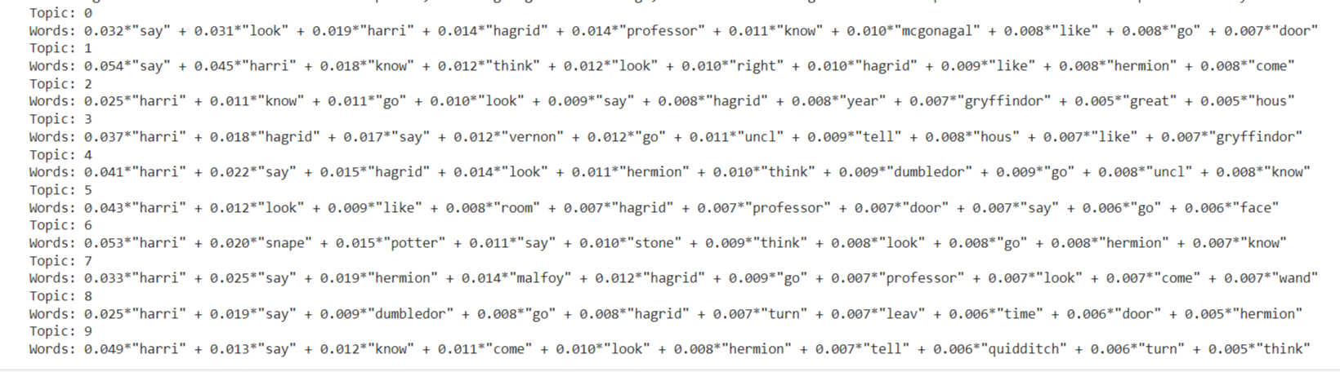
Faculty of Humanities
Applied Linguistics and Text Analytics
Nizhniy Novgorod
2024
Analysis process
Topic modeling
The code prints the 10 topics and their keywords generated by the lda_model using the print_topics method.

Slide 27
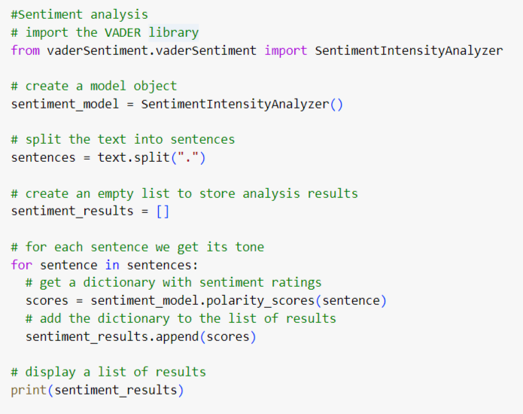
Faculty of Humanities
Applied Linguistics and Text Analytics
Nizhniy Novgorod
2024
Analysis process
Sentiment analysis
This code is an example of text sentiment analysis using the vaderSentiment library. The code prints the sentiment_results list to the screen using the print function

Slide 28
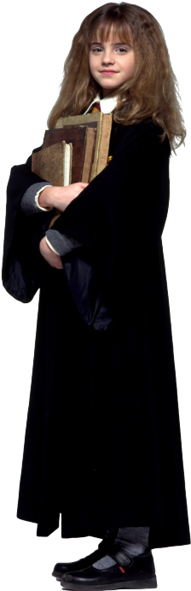
Faculty of Humanities
Applied Linguistics and Text Analytics
Nizhniy Novgorod
2024
Conclusions
All previously set goals were achieved.
When analyzing the book using Python tools, the following were identified:
book characters,
frequency parts of speech,
the degree of similarity between the books "Harry Potter and the Philosopher's Stone", "Harry Potter and the Chamber of Secrets" and "Harry Potter and the Prisoner of Azkaban",
main themes of the text,
emotional tone of the text.
We are currently concentrating on a single book and have used the similarity method to compare the first three books with each other. However, in the future, we can extend the analysis to encompass the entire series of Harry Potter books, enabling us to interpret the results and compare the plotlines across the entire series.

